Slide 2
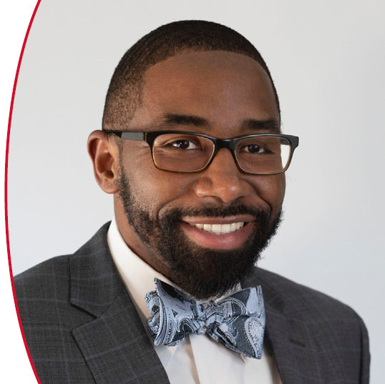
Presented by
Jonathan Madison

Slide 3
What are TMS Functional Committees?
Functional Committees work on addressing issues that have an impact on our professional life and the future of our field, as well as the future of TMS
Committee volunteers represent a variety of different backgrounds and specialties from industry, national labs, government, and academia
Functional Committees can help recommend and develop activities and resources for both the Society administration and TMS membership, including such things as:
Professional Development Course Creation
Diversity, Equity, and Inclusion Initiatives and Activities
Student Programming
Materials Community Representation in Public and Government Affairs
Honors and Professional Recognition
Supporting TMS Strategic Goals
Note: TMS Functional Committees are sometimes also referred to as Administrative Committees

Slide 4
What is the Difference Between a Functional and Technical Committee?
Technical Committees: Participants usually specialize in a specific material science and engineering area. Most technical committees offer “open” memberships. You don’t need a special invitation to participate. Simply attend an in-person committee meeting, contact the chair, or fill out the Technical Committee Interest form at www.tms.org/Committees
Functional Committees: Participants represent all different types of materials science and engineering specialties. Members of these committees are usually appointed by the Vice-President of the TMS Board of Directors and serve for a set term. The committee chair is often a board director (i.e., for BOD-level committees).
Note: TMS membership is required to become a member of any TMS Functional or Technical Committee

Slide 5
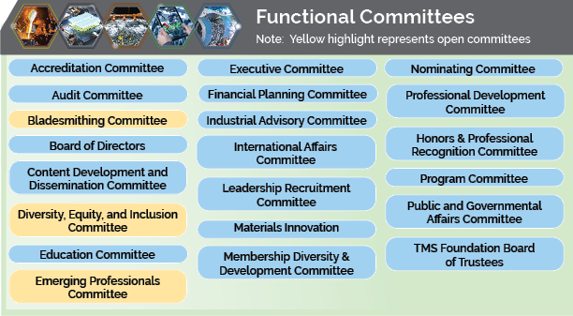
Functional Committees

Slide 6
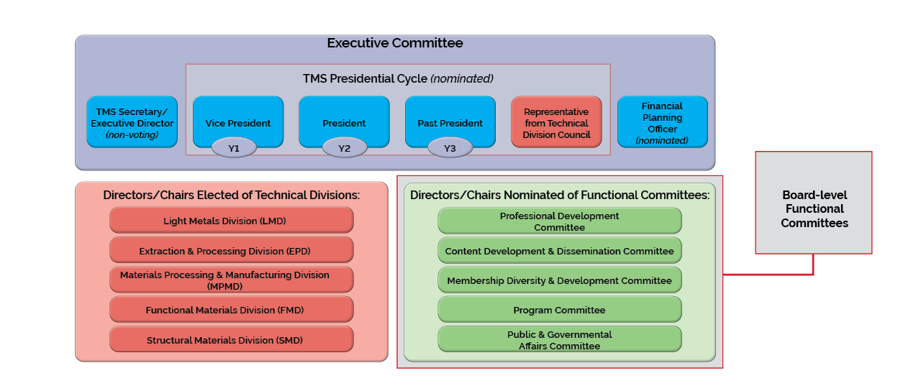
TMS Board of Directors (14 voting) & Executive Committee

Slide 7
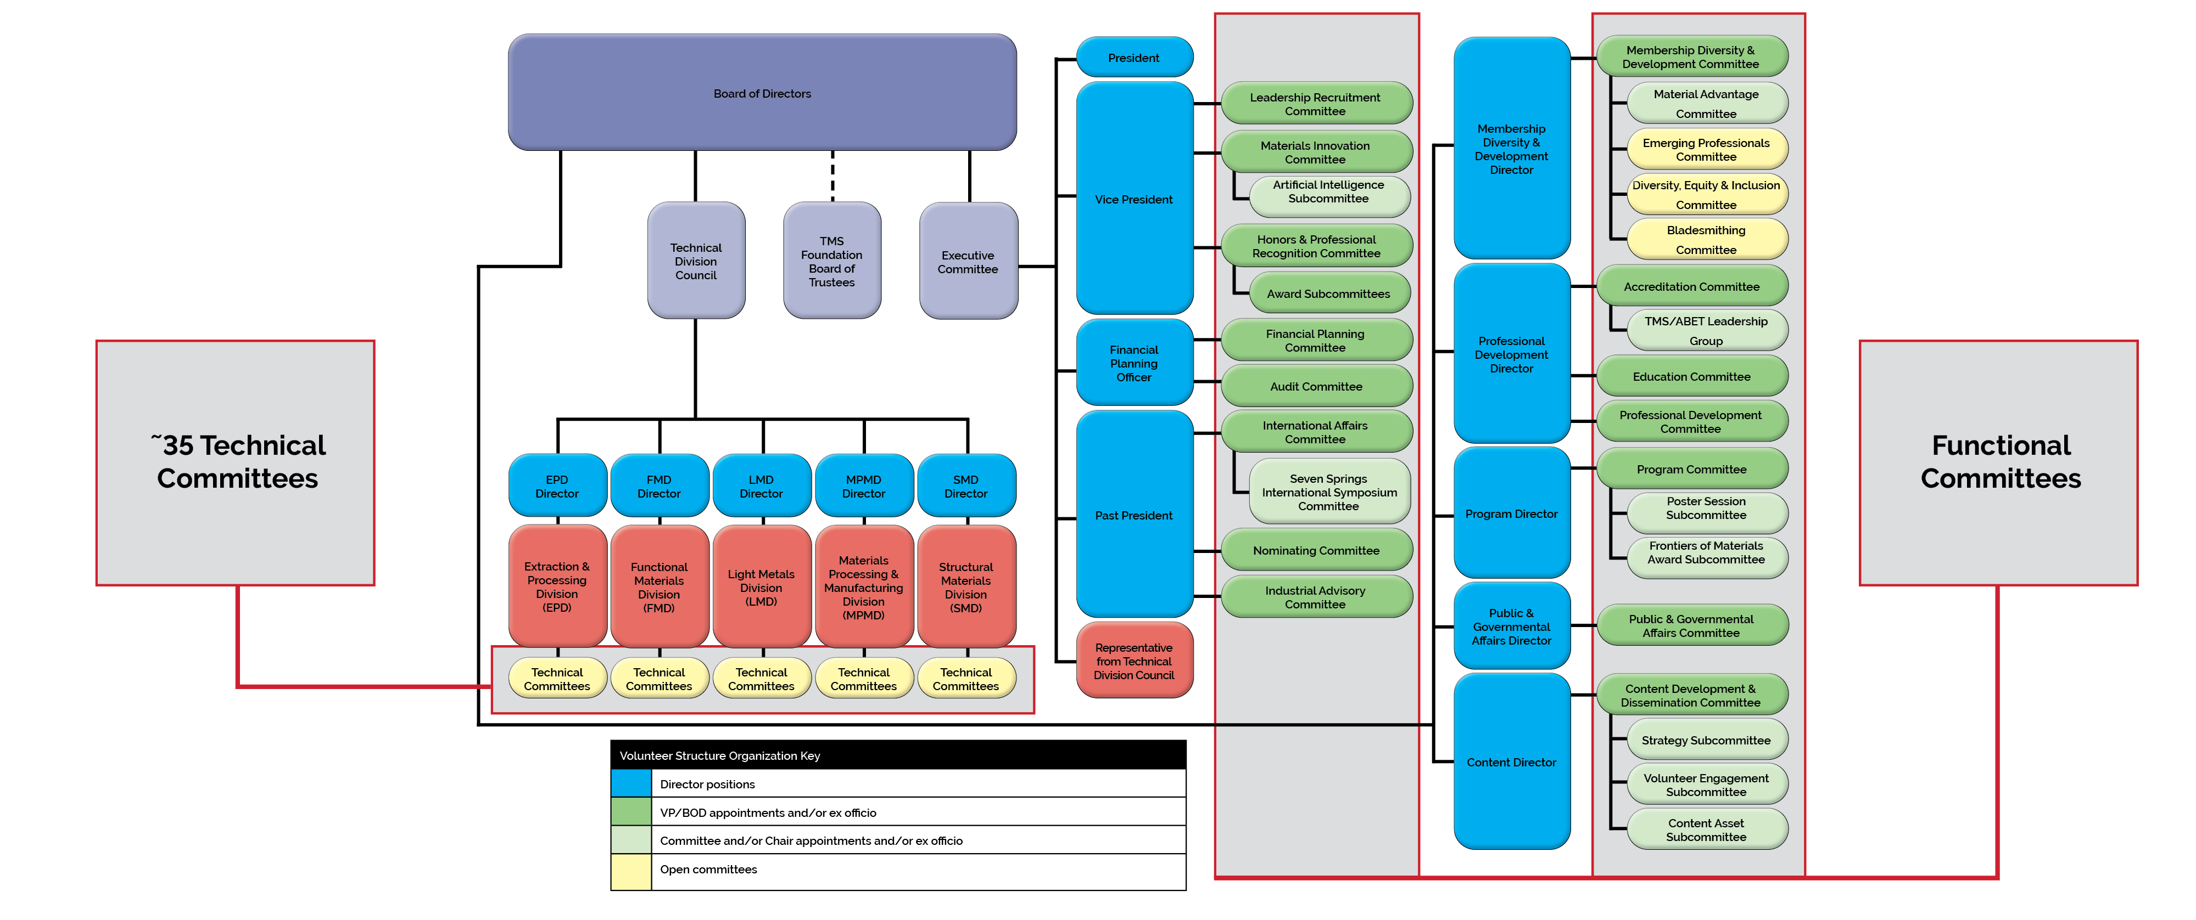
TMS Volunteer Organizational Structure

Slide 8
Functional Committees Have Term Limits
Most TMS Functional Committee volunteers are appointed for a specific length of time (usually 2-3 years).
The committee membership rotates each year. Sometimes there are only a handful of open roles.
Appointments occur at the end of the calendar year and official terms commence at the end of the TMS Annual Meeting & Exhibition.
Functional Committees typically have leadership roles including chair, vice chair, and past chair. Committee members can volunteer to lead working groups and special ad hoc committees.

Slide 9
Where Can You Find More Information About a Particular Committee?
TMS.org offers individual website pages for each functional committee. Committee homepages include the following:
Mission and scope of the committee
Staff liaison contact information
Chair information
Committee membership roster
Repository of documents (minutes, bylaws, roster) etc. for committee members’ use (you must be a TMS member to access this information)
Upcoming meeting notices
Find these pages at www.tms.org/Committees

Slide 10
Typical Functional Committee Meeting Schedule
TMS Annual Meeting (Most committees meet)
Summer (optional virtual meetings)
MS&T Conference (or Fall Virtual)
Note: Functional Committees have an email Listserv and pertinent information is shared as needed by the staff liaison or chair

Slide 11
What is a Committee vs. a Subcommittee?
Functional subcommittees (e.g., Emerging Professionals, Diversity Equity & Inclusion, Material Advantage, Bladesmithing) report to their overseeing functional committee.
The subcommittee chair is a member of the ‘parent’ committee. Any motions or subcommittee outcomes must first be approved by the overseeing functional committee.
Most Functional Committees have a direct line to the board of directors, while subcommittees need to present projects and outcomes to their parent functional committee for approval. The functional committee then submits the recommendations to the Board of Directors.

Slide 12
Some Subcommittee Volunteer Opportunities
Emerging Professional Committee provides a forum for early careerists that supports professional development and social consciousness through opportunities to interact professionally and socially with peers.
How to Join: Contact TMS Staff Liaison or Committee Chair. Membership is open to any member under 40 years of age or no more than 10 years past their final degree, whichever occurs last.
Diversity, Equity & Inclusion Committee seeks to advance TMS's commitment to diversity, equity, and inclusion in the minerals, metals, and materials science and engineering fields.
How to Join: Contact TMS Staff Liaison or Committee Chair. Multiple short-term working group volunteer opportunities available.
Bladesmithing Committee advises on the Bladesmithing competition and symposium to be held at the TMS annual meeting.
How to Join: Contact TMS Staff Liaison or Committee Chair.

Slide 13
Closing Thoughts
Not every position opens up every year (there are 2-, 3-, or 4-year cycles), so if you have a specific interest, know when they open up. TMS Staff Committee Liaisons are great contacts if you have questions (check the committee website)
Most functional sub-committees (as well as all technical committees) have open meetings, so if you are interested and it is on the schedule at a conference, feel free to show up.
A great first step is joining an open subcommittee such as TMS Emerging Professionals or Diversity, Equity & Inclusion.
Engage your mentors and sponsors in both helping you understand where you want to go and helping you get there.
Volunteers are the fuel that powers the society!

