Slide 2
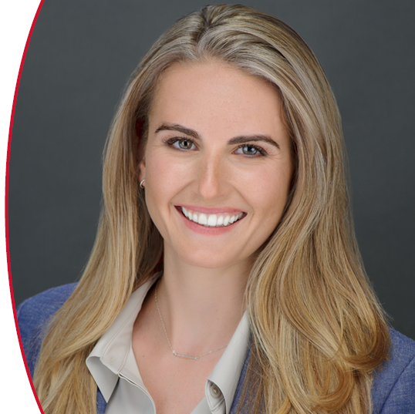
Presented by
Alexandra Anderson
RHI Magnesita

Slide 3
TMS Annual Meeting and Exhibition
Our Biggest Event of the Year.
More than 4,000 scientists and engineers from around the world gather each year.
Roughly 90 to 100 symposia presented, representing all five TMS technical divisions.
A robust exhibit features a variety of companies.
TMS Technical and Functional Committees hold in-person meetings.
Networking opportunities and social activities help you to meet colleagues and leaders in your field.

Slide 4
TMS Annual Meeting & Exhibition
A Chance to Network
Here are just a few examples of recurring events to attend:
Materials Bowl: This fast-paced student competition is held on Sunday afternoon.
Opening Reception: Get acquainted or re-acquainted with colleagues on the first night of the meeting.
Exhibit Hall: Browse exhibitor displays and (in even-numbered years) check out the popular Bladesmithing exhibit.
Awards Ceremony: Celebrate your colleagues’ achievements.

Slide 5
TMS Fall Meeting at Materials Science & Technology (MS&T)
MS&T is organized by:
TMS
Association for Iron & Steel Technology (AIST)
American Ceramic Society (ACerS)
TMS-specific programming and events are highlighted on the TMS Fall Meeting website and on the MS&T App

Slide 6
TMS Specialty Congress and Specialty Meetings
Great opportunities to network with colleagues in your field!
TMS Specialty Congress:
Convenes recurring specialty meetings under one roof with a single registration fee
Combines focused technical communities with cross-disciplinary opportunities
TMS Specialty Meetings:
Research from academia, government, and industry are presented on topics from extraction to practical/end use.

Slide 7
Expert Tips for Successful Meetings
Be Prepared: For the TMS Annual Meeting and MS&T, this means downloading the conference app and building a schedule for the week. Both of these conferences have multiple concurrent sessions, so planning ahead is key. For smaller meetings, access the conference websites for planning materials.
Check Your Email: The week prior to a meeting, you’ll typically receive a message with key information on events, activities, and answers to frequently asked questions.
Avoid the Lines: Get your badge and materials from the Registration Desk on Sunday so you can attend any evening opening receptions and beat the Monday morning rush.
Use Your Tickets: Your registration fee often includes reception events and/or meals; check the back of your name badge for tickets to these events.
Wear Comfortable Shoes: You may want to sample a variety of sessions in different locations, and that means a lot of walking.

Slide 8
Expert Tips for a Successful Meeting
Be a Prepared Presenter: If you are presenting a talk, go to your session room early to meet with session chairs and ask any questions you may have. A laptop will be provided in the room, but you can also use your own.
Be Interactive: Don’t be afraid to ask questions of the presenters. This isn’t just about disseminating information; it’s also about collaborating with your peers.
Get Involved: TMS technical committees hold in-person meetings at the TMS Annual Meeting and at MS&T. These meetings are open to all TMS members and are a great way to increase your involvement in the Society. Check the app for schedule details.

Slide 9
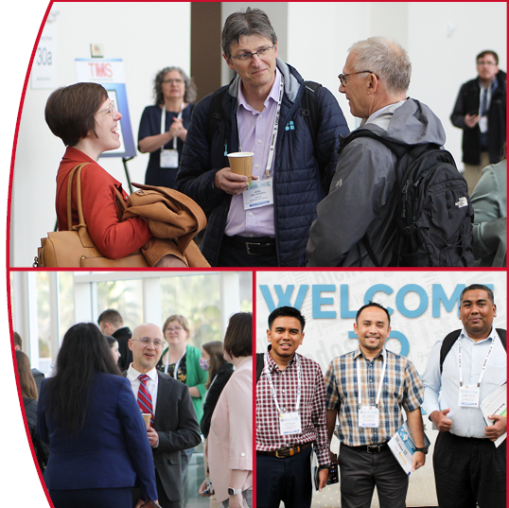
For More Information
Plan to meet up with your fellow members at an upcoming conference. TMS members receive significant registration discounts on all events.
Learn more about Upcoming Meetings at:
www.tms.org/Meetings

